Slide 1
JS Overview
Single Page Application with Angular
Brygar Ivan & Romanov Alexander
Developer and QA in Sustained Engineering Team
ivb@sitecore.net / arr@sitecore.net October 2014

Slide 2
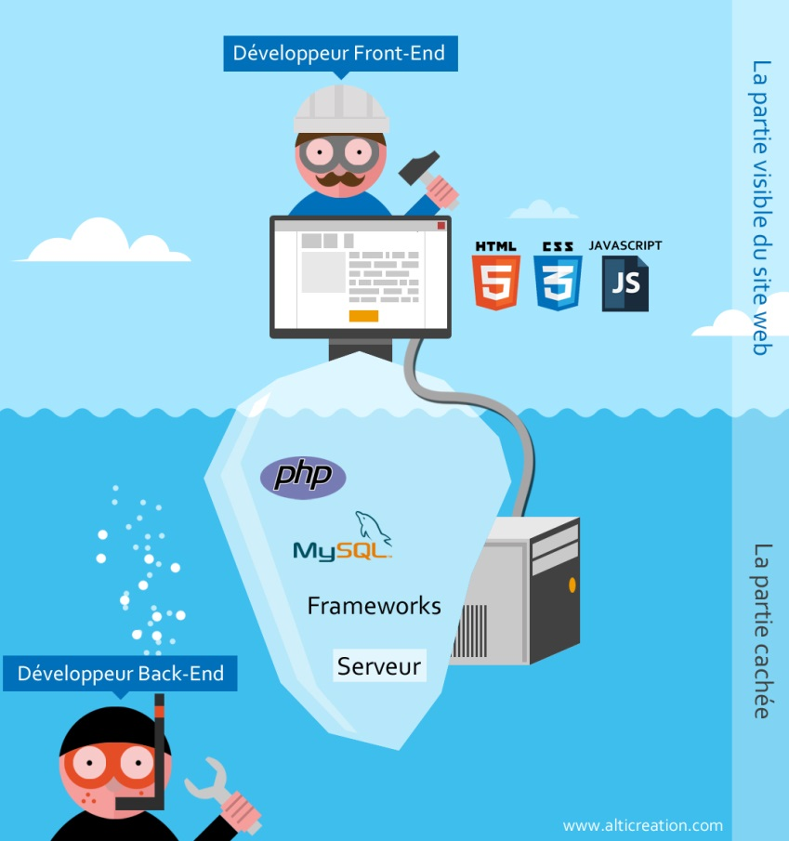
Where is going JS?
Logic in front-end (obviously), but quite complicated than before.
Back-end like a CRUD

Slide 3
Evolution of JS
Few words about OOP
JS don’t have concept of class, but have objects.
Programming with functions and objects (example: C# - programming with classes and objects)
ES 6 is coming…
new keywords: class, public, private, import (similar to using, works even through http).
Not stable yet, some keywords changing.
Tool ES 6 => ES 5

Slide 4




Evolution of JS
jQuery – fresh breath for developers (encapsulated all difficulties of JS, cross-browser).
JS Frameworks – architecture basement (Knockout, Backbone, AngularJS, etc).
Angular advantages – everything from the box, if use another frameworks, need to combine with another libraries.

Slide 5
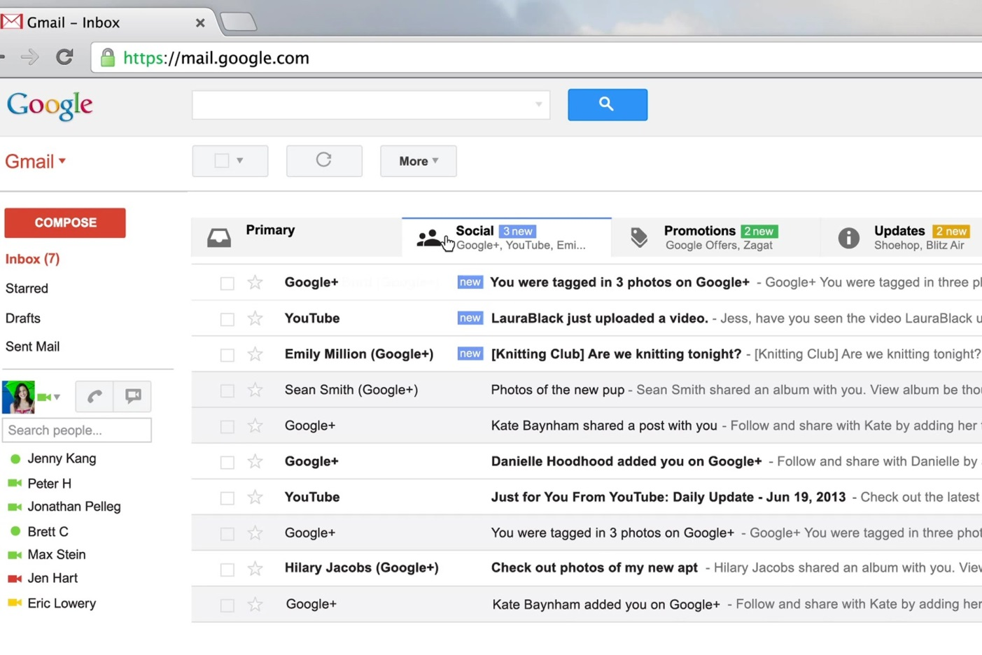
Single Page Application (SPA)
Frameworks helps create SPA application.
Example of SPA.
Advantages (No Page Refresh - websites surely are extremely responsive, Mobile Preferred, Better Google PageRank)
Disadvantages - ?

Slide 6

JS and SEO
Minification, Uglification – load time and count of files is important.
CDN
Tools:
UglifyJS
Google Closure Tools
YUI Compressor

Slide 7
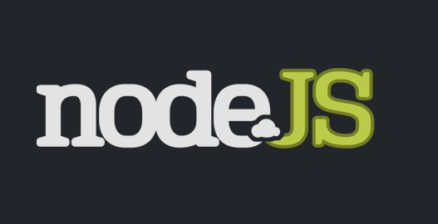

JS in back-end (NOT DONE YET)
Few words about Node.js
What is it NPM?

Slide 8

JS automation
Few words about Grunt, how it helps?
In one word: automation. The less work you have to do when performing repetitive tasks like minification, compilation, unit testing, linting, etc, the easier your job becomes. After you've configured it through a Gruntfile, a task runner can do most of that mundane work for you—and your team—with basically zero effort

Slide 9

JS scaffolding
Yeoman (written by Node.js)
Yes, it’s possible install Yeoman from npm. (npm install yeoman)
Help developers quickly build high quality web applications

Slide 10


JS only for Web?
Ionic framework - open source front-end framework for developing hybrid mobile apps with HTML5.
PhoneGap - open source framework that allows you to create mobile apps using standardized web APIs for the platforms you care about

Slide 11


Plan for demo
Build SPA (Single Page Application) step by step
Create tests for SPA using protractor

